Slide 1




My Algebra Interactive Notebook
$$3ab$$
$$2x+3y$$
$$\frac{5xy}{6}$$
Name :
Class :
Term 2 Semester 1
$$y=2x+1$$

Slide 2
Contents
Glossary
Page
Date
Description
2
3

Slide 3
Tasks
24
7
30
Essential Question
Questions
Notes
Summary
4
5

Slide 4
24
7
30
Date
Introduction to Algebra
EQ – What are some of the keywords that I need to know when solving problems using letter symbols?
5

Slide 5
24
7
30
Date
Introduction to Algebra
EQ – What are some of the keywords that I need to know when solving problems using letter symbols?
In algebra we use letters to represent numbers.
5

Slide 6
24
7
30
Date
Introduction to Algebra
EQ – What are some of the keywords that I need to know when solving problems using letter symbols?
In algebra we use letters to represent numbers.
These letters are called variables or pronumerals.
5

Slide 7
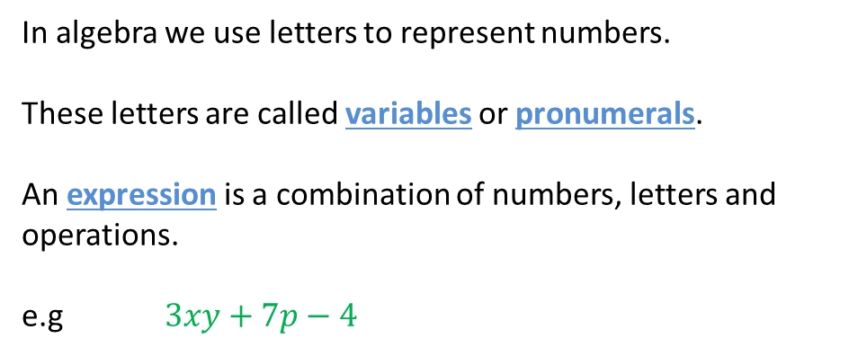
24
7
30
Date
Introduction to Algebra
EQ – What are some of the keywords that I need to know when solving problems using letter symbols?
In algebra we use letters to represent numbers.
These letters are called variables or pronumerals.
An expression is a combination of numbers, letters and operations.
e.g $3xy+7p−4$
5

Slide 8
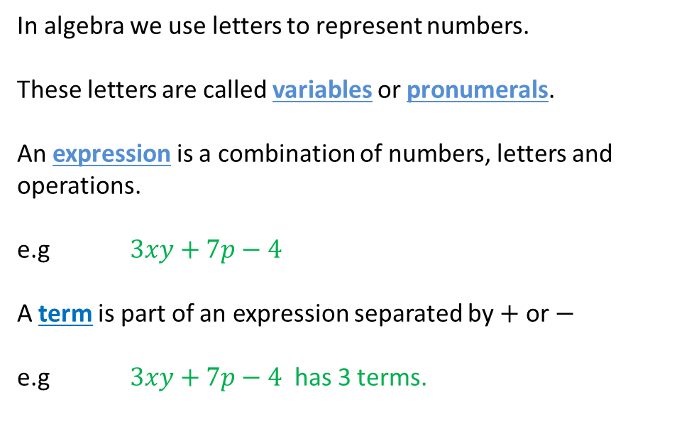
24
7
30
Date
Introduction to Algebra
EQ – What are some of the keywords that I need to know when solving problems using letter symbols?
In algebra we use letters to represent numbers.
These letters are called variables or pronumerals.
An expression is a combination of numbers, letters and operations.
e.g $3xy+7p−4$
A term is part of an expression separated by $+$ or $−$
e.g $3xy+7p−4$ has 3 terms.
5

Slide 9

24
7
30
Date
Introduction to Algebra
EQ – What are some of the keywords that I need to know when solving problems using letter symbols?
In algebra we use letters to represent numbers.
These letters are called variables or pronumerals.
An expression is a combination of numbers, letters and operations.
e.g $3xy+7p−4$
A term is part of an expression separated by $+$ or $−$
e.g $3xy +7p−4$ has 3 terms.
5

Slide 10

24
7
30
Date
Introduction to Algebra
EQ – What are some of the keywords that I need to know when solving problems using letter symbols?
In algebra we use letters to represent numbers.
These letters are called variables or pronumerals.
An expression is a combination of numbers, letters and operations.
e.g $3xy+7p−4$
A term is part of an expression separated by $+$ or $−$
e.g $3xy +7p−4$ has 3 terms.
5

Slide 11
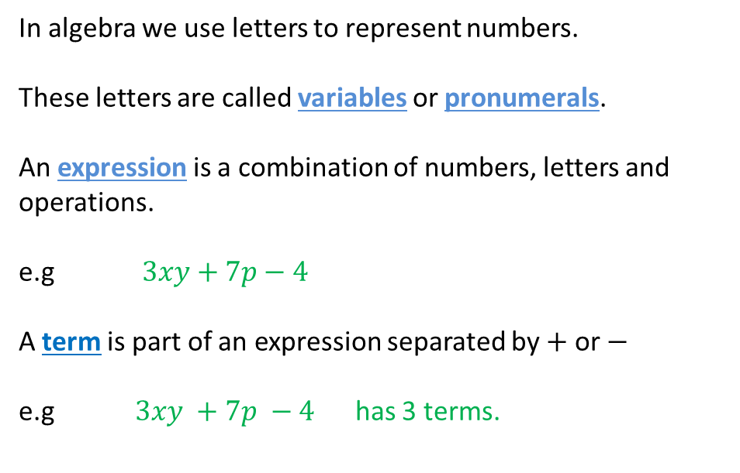
24
7
30
Date
Introduction to Algebra
EQ – What are some of the keywords that I need to know when solving problems using letter symbols?
In algebra we use letters to represent numbers.
These letters are called variables or pronumerals.
An expression is a combination of numbers, letters and operations.
e.g $3xy+7p−4$
A term is part of an expression separated by $+$ or $−$
e.g $3xy +7p −4$ has 3 terms.
5

Slide 12
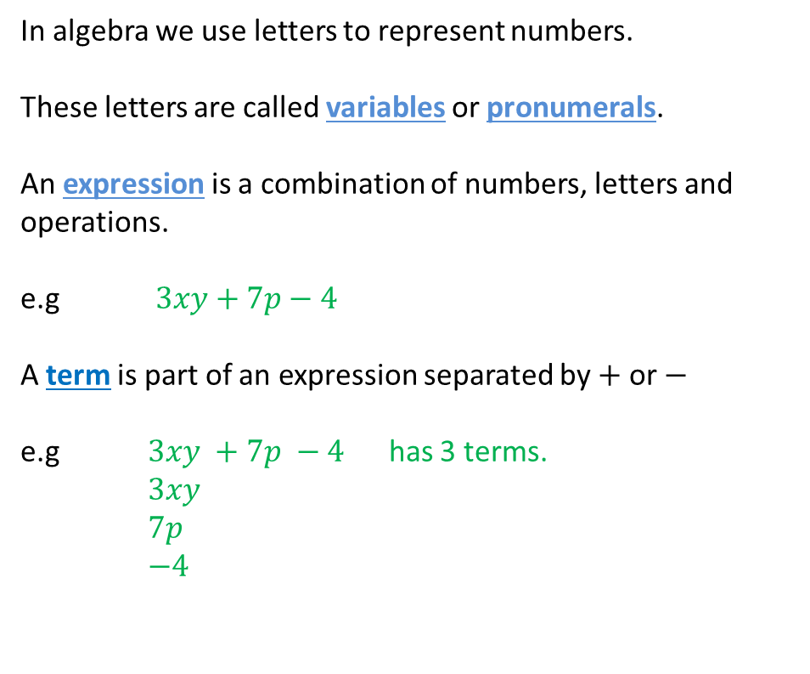
24
7
30
Date
Introduction to Algebra
EQ – What are some of the keywords that I need to know when solving problems using letter symbols?
In algebra we use letters to represent numbers.
These letters are called variables or pronumerals.
An expression is a combination of numbers, letters and operations.
e.g $3xy+7p−4$
A term is part of an expression separated by $+$ or $−$
e.g $3xy +7p −4$ has 3 terms.
$3xy$
$7p$
$−4$
5

Slide 13
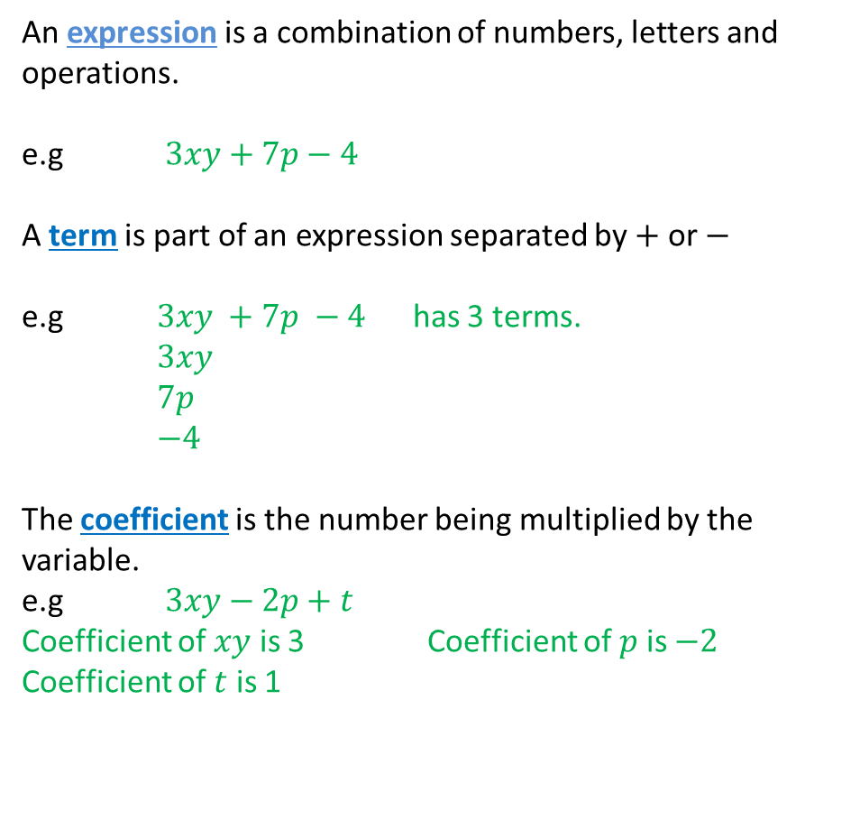
24
7
30
Date
Introduction to Algebra
EQ – What are some of the keywords that I need to know when solving problems using letter symbols?
An expression is a combination of numbers, letters and operations.
e.g $3xy+7p−4$
A term is part of an expression separated by $+$ or $−$
e.g $3xy +7p −4$ has 3 terms.
$3xy$
$7p$
$−4$
The coefficient is the number being multiplied by the variable.
e.g $3xy−2p+t$
Coefficient of $xy$ is 3 Coefficient of $p$ is $−2$
Coefficient of $t$ is 1
5
Notes:
iv

Slide 14
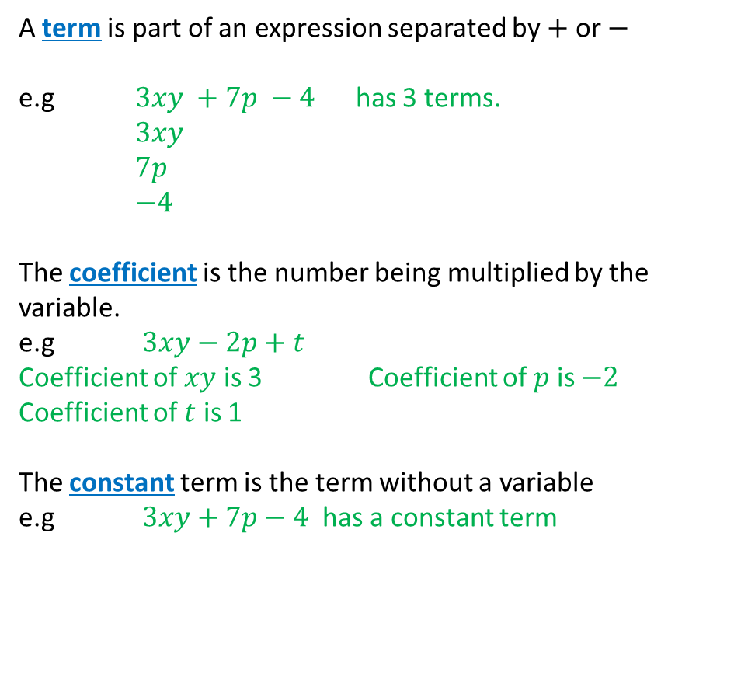
24
7
30
Date
Introduction to Algebra
EQ – What are some of the keywords that I need to know when solving problems using letter symbols?
A term is part of an expression separated by $+$ or $−$
e.g $3xy +7p −4$ has 3 terms.
$3xy$
$7p$
$−4$
The coefficient is the number being multiplied by the variable.
e.g $3xy−2p+t$
Coefficient of $xy$ is 3 Coefficient of $p$ is $−2$
Coefficient of $t$ is 1
The constant term is the term without a variable
e.g $3xy+7p−4$ has a constant term
5
Notes:
iv

Slide 15
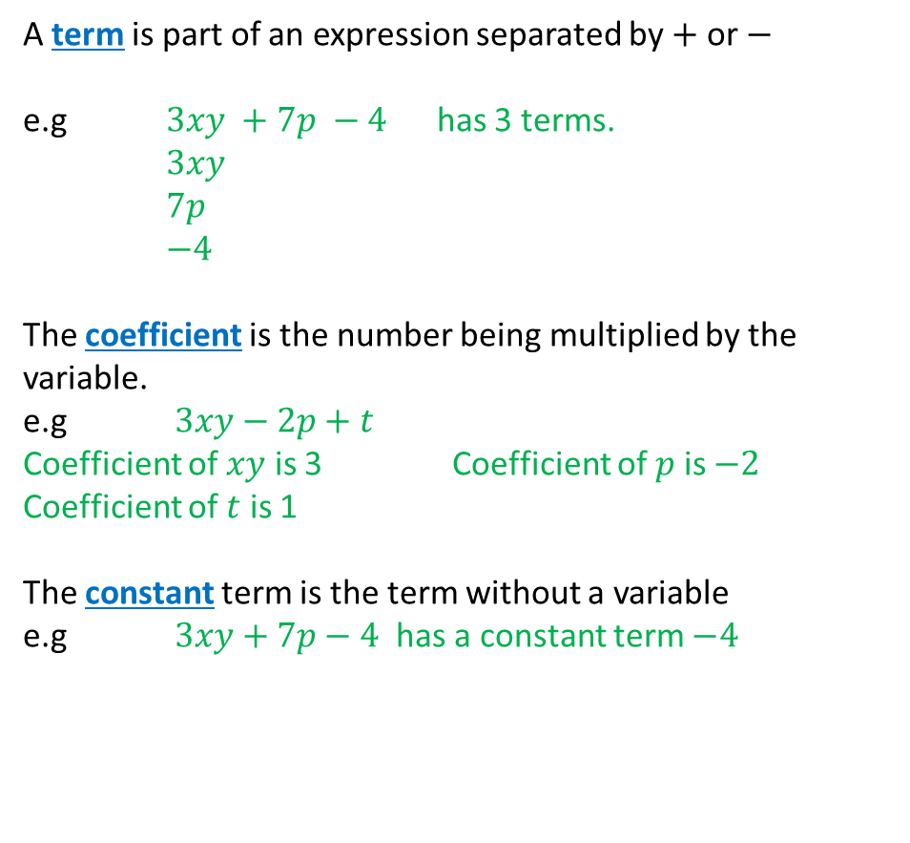
24
7
30
Date
Introduction to Algebra
EQ – What are some of the keywords that I need to know when solving problems using letter symbols?
A term is part of an expression separated by $+$ or $−$
e.g $3xy +7p −4$ has 3 terms.
$3xy$
$7p$
$−4$
The coefficient is the number being multiplied by the variable.
e.g $3xy−2p+t$
Coefficient of $xy$ is 3 Coefficient of $p$ is $−2$
Coefficient of $t$ is 1
The constant term is the term without a variable
e.g $3xy+7p−4$ has a constant term $−4$
5
Notes:
iv

Slide 16
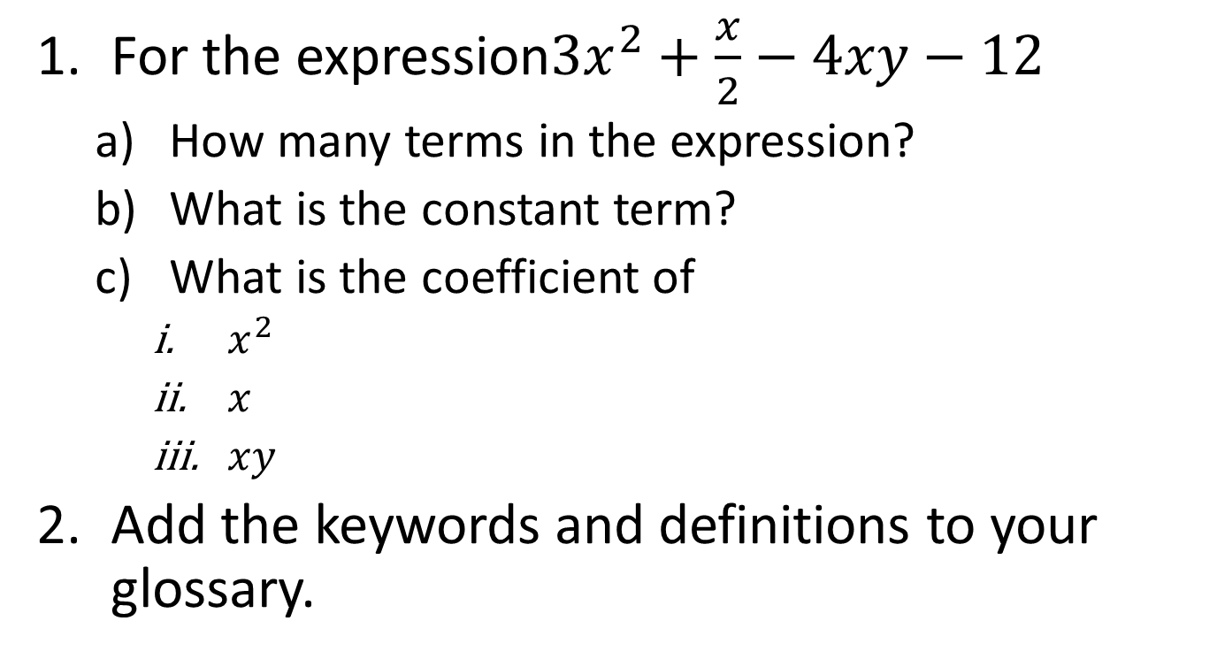
Task
For the expression$3x^{2}+\frac{x}{2}−4xy−12$
How many terms in the expression?
What is the constant term?
What is the coefficient of
$x^{2}$
$x$
$xy$
Add the keywords and definitions to your glossary.

Slide 17
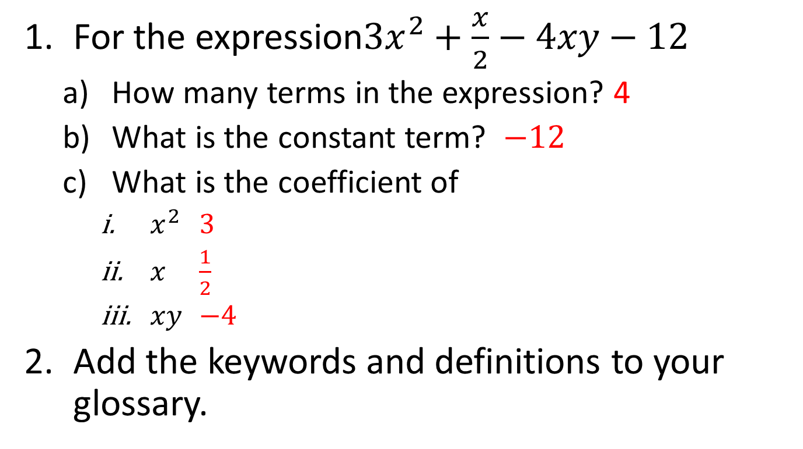
Task
For the expression$3x^{2}+\frac{x}{2}−4xy−12$
How many terms in the expression? 4
What is the constant term? $−12$
What is the coefficient of
$x^{2}$ 3
$x$ $\frac{1}{2}$
$xy$ $−4$
Add the keywords and definitions to your glossary.

Slide 18
Fill in the questions

Slide 19
Notes Review
24, 7 ,30
Date
Title
Essential question
Notes complete
Notes complete with colour and diagrams
Questions completed
Contents page filed in
Formula page filled in

Slide 20
Homework
Review your notes and write a summary answering the essential question.

